Slide 1

SMRTS App
(Small Engine Repair Ticket System Project)
By: Pablo Cesar Chavez-Lopez
https://github.com/ksu-is/SMR-Ticket-System

Slide 2
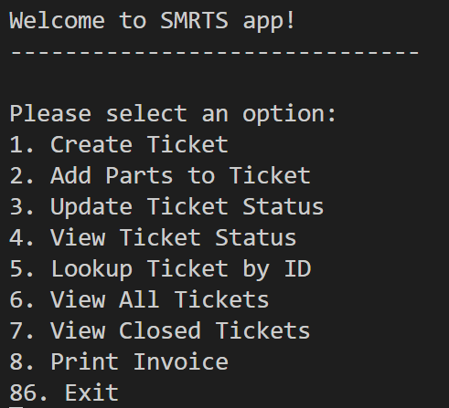
Project Overview
SMRTS is a lightweight, Python-powered terminal application designed to streamline service ticket tracking for small repair teams. With intuitive menu options, users can create, update, and review tickets, log parts, print invoices, and quickly locate service history. Built for simplicity and speed, SMRTS operates entirely through the command line, making it efficient and scalable without the overhead of complex software.
Key Features:
- Create and manage service tickets
- Lookup by ID & update ticket status
- Add parts, view closed & open history
- Print invoices via terminal interface
Whether you're tracking repairs or managing workflows, SMRTS gets it done — fast, clean, and smart.

Slide 3



Why a Ticket System?
- Scalability
- Ease of use
- Offline Access

Slide 4
Sources
GitHub Repo: GeraldTgit/aharts: A ticketing system for my father's Home Appliances Repair shop.
Youtube Tutorial: I CREATE TICKET MANAGEMENT SYSTEM USING PYTHON & LEARN PYTHON BY BUILDING SIMPLE PROJECTS

Slide 5




Scope of Project
Originally just:
Create
Update
View all
New Features:
Update Ticket
Look up with ID
Generate Invoice
Add Parts

Slide 6


Roadblocks/Issues
Functions not updating defined variables
Issue with adding multiple parts for tickets

Slide 7
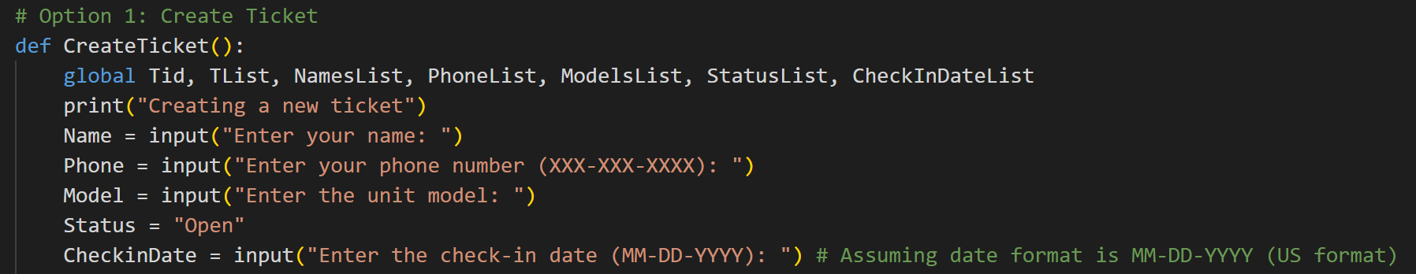
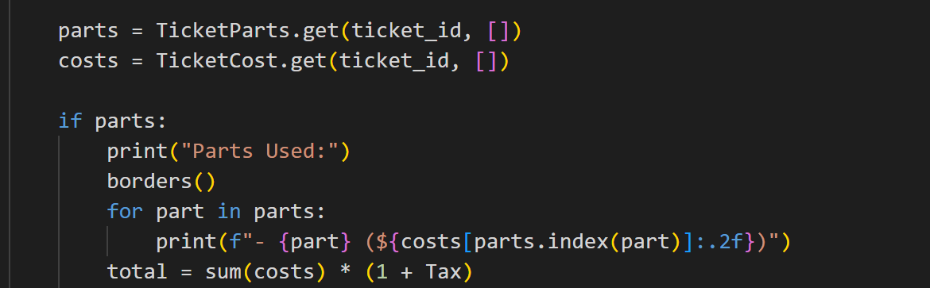
Solutions
Global command
Dictionary with For loop

Slide 8




Future Development
Full UI development
Customer view with secure login
Payment
Push Notifications
Saving data externally

Slide 9
Thank you!
Pablo Cesar Chavez-Lopez
pchavezl@students.Kennesaw.edu
https://github.com/ksu-is/SMR-Ticket-System

